Slide 1

Leveraging ML Solutions to Identify Genomic Signatures in AMD
Sponsor
Dr. Rinki Ratnapriya
Mentor
Maryam Khalid
Team
Duy Ha, Patrick Yee, Sujitha Ravichandran, Qingxin Yuan, Wanying Xu, Tian Xia
Notes:
1. (Title) We are team BCM-AMD, and we’re so excited to share our project with you!

Slide 2

Age- Related Macular Degeneration (AMD) is an eye disease that can blur central vision.
200 million people worldwide suffer from AMD
About 1 in 10 Americans aged 50 and older have the early form of AMD.
Prevalence of age-related macular degeneration (AMD) - Prevent blindness. Prevent Blindness. https://preventblindness.org/amd-prevalence-vehss/ , Nov 2022.
Notes:
2. Age related macular degeneration (AMD) is an eye disease that causes the degradation of forward-facing high focus vision. This disease is extremely common, affecting 10% of Americans over the age of 50, and has no known cure.

Slide 3




Causes of AMD
Genetics
Large # of genes (~18K) → difficult to identify contributing genes
Gene Expression Regulation → Uncertainty in how disease-associated DNA variants regulate gene expression affecting AMD risk.
Lifestyle & Environmental Risk Factors
Notes:
3. The causes of AMD are thought to include a mix of lifestyle factors and genetic predispositions, but they are not well understood. This is because there are a large number of genes to consider, and because a lot of these genes have subtle expression changes that are difficult to analyze.

Slide 4


Objectives
(1) Feature extraction, dimensionality reduction, and engineering.
Identify critical genomic signatures related to AMD.
(2) Interpretable modeling of AMD labels from reduced data.
Use statistical and ML methods to predict AMD.
Explain those models
(3) Deployable Python package.
Wrap our pipeline in a generalizable Python package to be used by medical professionals.
To achieve these objectives, we design a 5-step Pipeline
Notes:
4. That’s where we come in. The objectives of this project are threefold. First, we perform feature extraction and engineering to simplify our high-dimensional data down to the core features most closely related to AMD. Second, we use these simplified features to predict AMD from a small number of observations, and finally, we wrap our pipeline in a Python package that can easily be deployed by medical professionals.

Slide 5



Postmortem Retinas from 453 Patients
18056 genes
Data Description
Notes:
5. To accomplish these goals, we have been presented with postmortem transcriptome data from 453 donors, which includes expression levels of 18000 genes as well as relevant metadata.
- can't mention transcriptome data

Slide 6

1. Initial filtering
18,056 Genes
Statistical Filtering
Variance threshold
+ Kolmogorov Smirnov test
+ Wald test
+ Rank-sum test
652 Genes

Slide 7
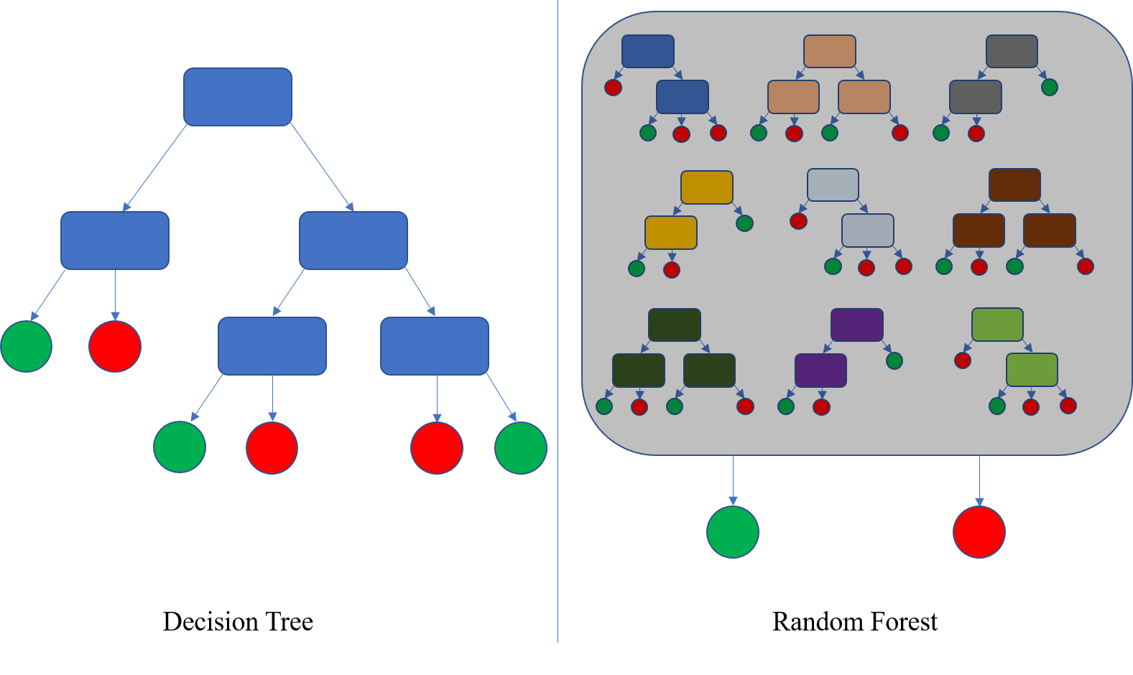
2. Ranking genes
18,056 Genes
Statistical Filtering
Variance threshold
+ Kolmogorov Smirnov test
+ Wald test
+ Rank-sum test
652 Genes
Ranked list of 652 Genes
Gene ranking
PCA, MRMR, Random Forest

Slide 8
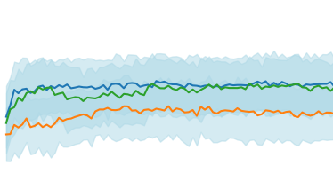
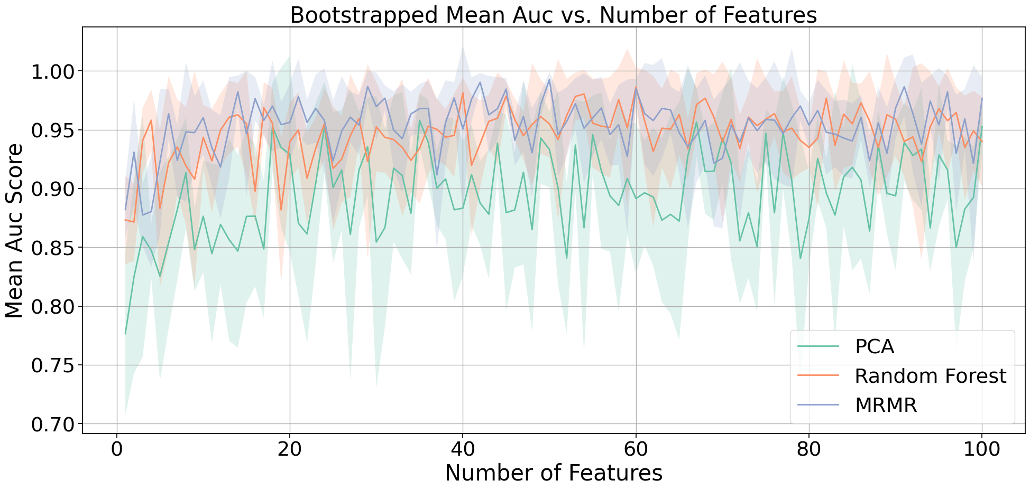
3. Top k genes
18,056 Genes
Statistical Filtering
Variance threshold
+ Kolmogorov Smirnov test
+ Wald test
+ Rank-sum test
25 Genes
652 Genes
Top k
Elbow plots
Ranked list of 652 Genes
Gene ranking
PCA, MRMR, Random Forest

Slide 9
3. Top k genes
18,056 Genes
Statistical Filtering
Variance threshold
+ Kolmogorov Smirnov test
+ Wald test
+ Rank-sum test
25 Genes
652 Genes
Top k
Elbow plots
Ranked list of 652 Genes
Deliverable #1:
Final list of selected genes
Gene ranking
PCA, MRMR, Random Forest

Slide 10
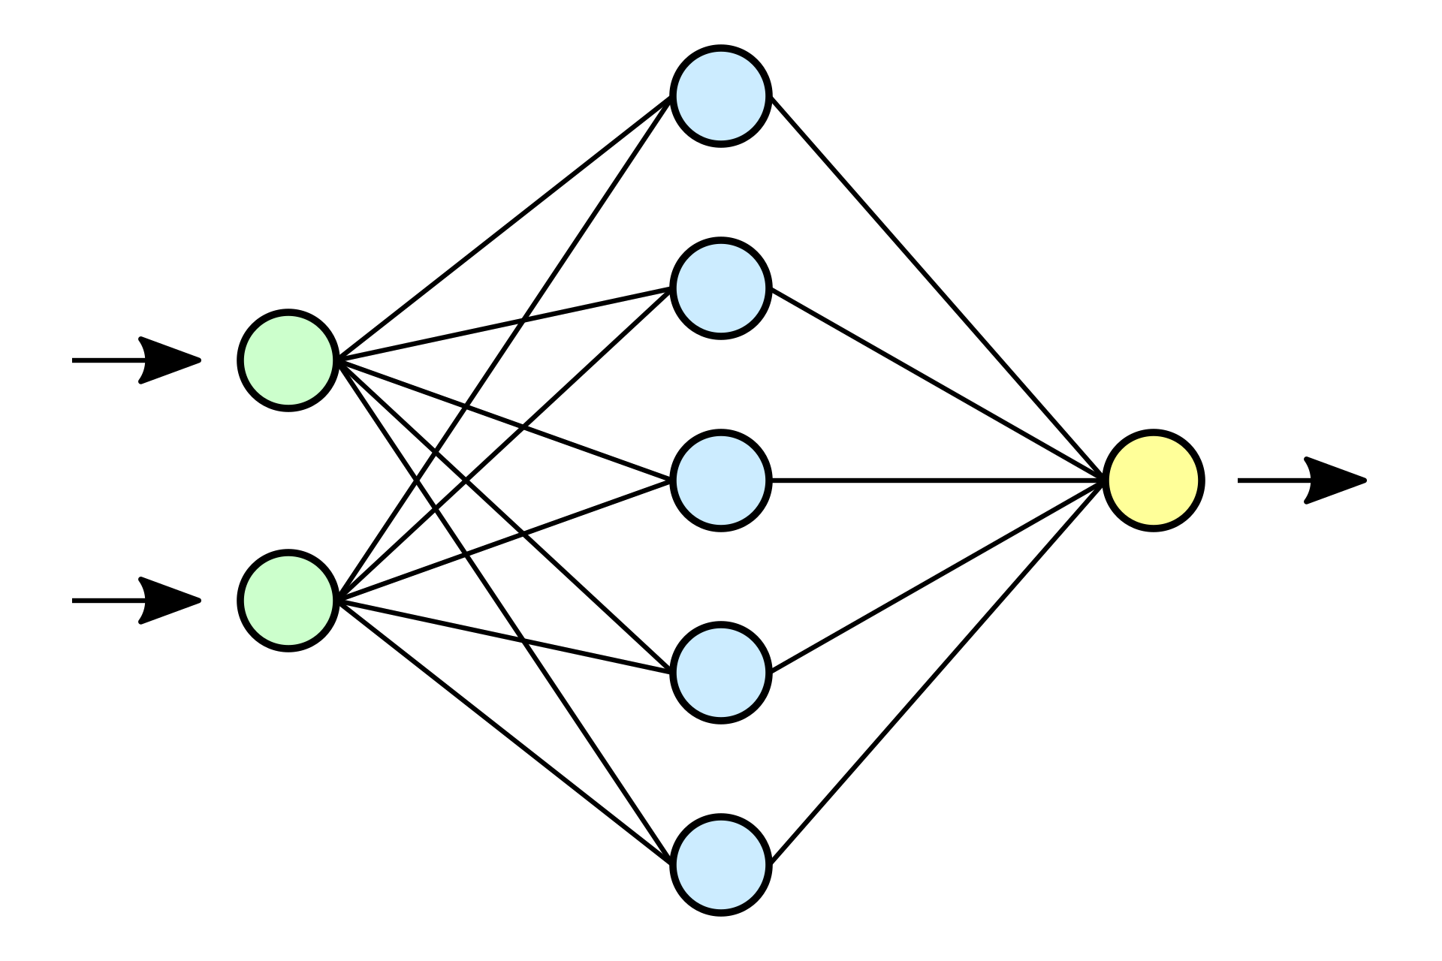
4. Modeling
Modeling
XGB, RF, Neural Networks
18,056 Genes
> 95% AUC on test set
Statistical Filtering
Variance threshold
+ Kolmogorov Smirnov test
+ Wald test
+ Rank-sum test
25 Genes
652 Genes
Top k
Elbow plots
Ranked list of 652 Genes
Deliverable #1:
Final list of selected genes
Gene ranking
PCA, MRMR, Random Forest

Slide 11
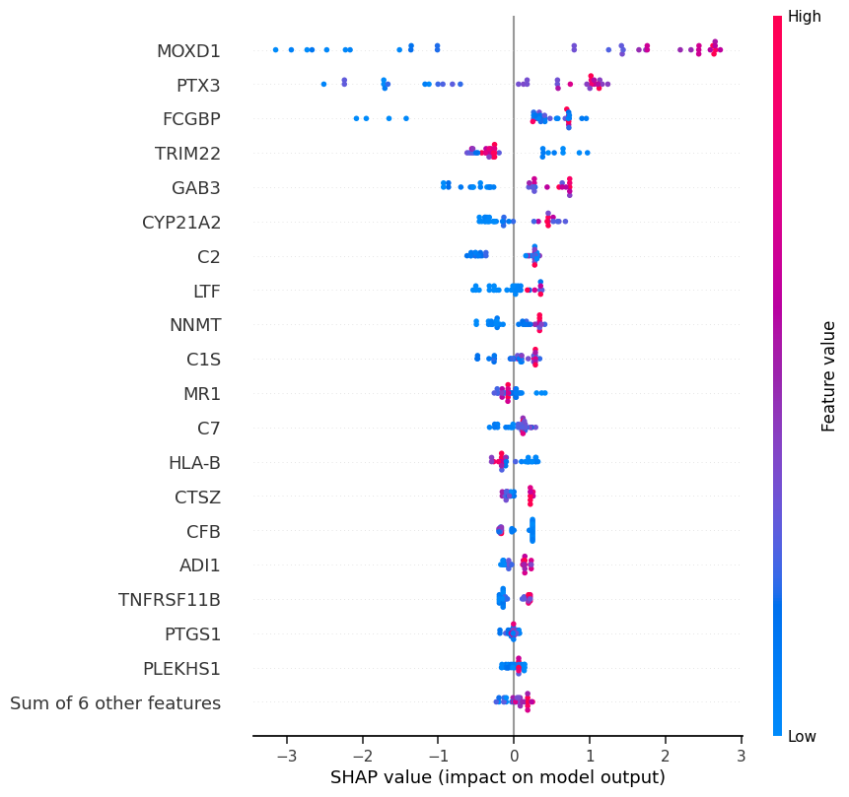
5. Interpretation
Modeling
XGB, RF, Neural Networks
18,056 Genes
> 95% AUC on test set
Statistical Filtering
Variance threshold
+ Kolmogorov Smirnov test
+ Wald test
+ Rank-sum test
25 Genes
652 Genes
Top k
Elbow plots
Interpretation
SHAP, Lime
Ranked list of 652 Genes
Deliverable #1:
Final list of selected genes
Gene ranking
PCA, MRMR, Random Forest

Slide 12
5. Interpretation
Modeling
XGB, RF, Neural Networks
18,056 Genes
> 95% AUC on test set
Statistical Filtering
Variance threshold
+ Kolmogorov Smirnov test
+ Wald test
+ Rank-sum test
25 Genes
652 Genes
Top k
Elbow plots
Interpretation
SHAP, Lime
Ranked list of 652 Genes
Deliverable #1:
Final list of selected genes
Gene ranking
PCA, MRMR, Random Forest
Deliverable #2:
Final modeling results with interpretation

Slide 13

Introducing DREAM-R
Dimensionality Reduction, feature Extraction, and Modeling for RNA transcriptome data
A deployable and generalizable genomic analytics package for medical professionals!
Deliverable #3:
Deployable and generalizable Python package
Notes:
We can name it something else as well.
We need to stay on this slide longer or show it sooner

Slide 14

Model Evaluation
Bootstrapped over 100 iterations on selected top k = 25 genes
Random Split train:test = 80:20
Method + XGBoost | Precision | Sensitivity | Specificity | F1 Score | AUC
MRMR | 0.900 ± 0.052 | 0.894 ± 0.054 | 0.922 ± 0.065 | 0.893 ± 0.054 | 0.946 ± 0.056
MRMR + XgBoost gives the highest performance ~ 95% AUC
Notes:
Qingxin
We resample the dataset 100 times on the selected top 25 genes
Following this, we implement an 80-20 train-test split
subsequently, we leverage the power of XGBoost model, integrating it with feature selection methods, and evaluating the models using a set of 5 different metrics
Here we are looking at the best performance model, the combination of MRMR feature selection with the XGBoost model, which gives us about 95% Area Under the Curve

Slide 15

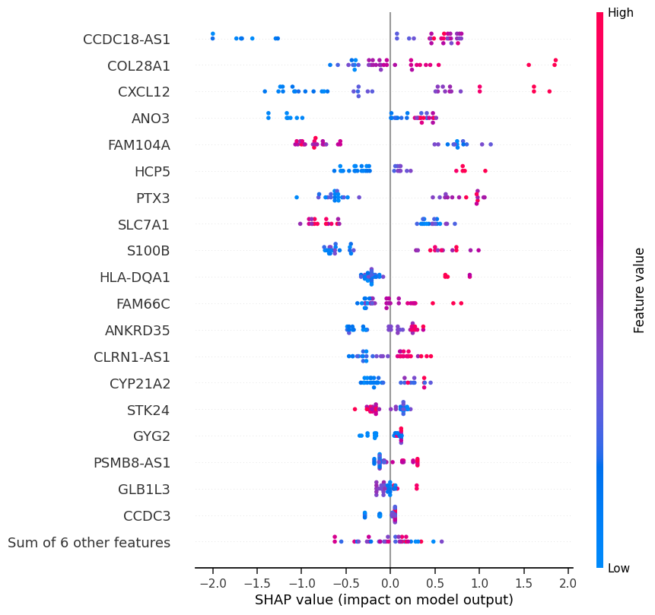
SHapley Additive exPlanations (SHAP): Interpreting the model
Game theoretic approach to explain the output of any ML model.
SHAP breaks down a prediction to show the impact of each feature
Conclusion: take the top 10 candidates for an example
Highly expressed genes in AMD subjects | Highly expressed genes in Control subjects
CCDC18-AS1, COL28A1, CXCL12, HCP5, PTX3, S100B, HLA-DQA1, FAM66C | FAM104A, SLC7A1
SHAP scores on test set for XGBOOST model with MRMR feature selection
Notes:
We do the interpretation on the best XGBoost model with SHAP. This beeswarm plot is a summary of how the top features in a dataset impact the model’s output. The x axis shows the features impact on the model. Negative values means the prediction is in the control group and positive means AMD group. The y axis are the feature names sorted by the impact. And the color bar on the right side indicates the feature values.

Slide 16

Balancing Act: ML systems and Gene Discovery Challenges
Ensemble models: high prediction performance, but sensitive to number of input genes
MRMR mitigates this issue but is not suitable for Complete Gene Discovery:
Tendency to mask important genes which are redundant with others
E.g: Biologically significant MOXD1 removed due to previously selected CCDC18-AS1.
Models sensitive to data normalization are not recommended:
Different genes are expressed on a different scale, thus data can not be normalized.
Statistical filtering is critical for stability of all ML methods.
High prediction performance is a double-edged sword:
The ability to accurately predict AMD from small set of genes detracts from the discovery of all crucial genes.
Future Directions:
Incorporating domain knowledge in ML models
Extending the problem to multiple stages of AMD
Integrating other risk factors
Notes:
(65s) We conducted a rigorous analysis investigating the reasons behind varying selected genes, rankings, and optimal gene counts across different models. Here are some of our results
Ensemble Models: While ensemble models offer high prediction performance, they are also sensitive to the number of input genes.
MRMR Limitations: We discovered that MRMR helped mitigate this particular issues of input sensitivity, but it is not ideal for complete gene discovery as it tends to mask important genes that are redundant with others. For example, MOXD1, a biologically significant gene found in other models, was removed after being deemed redundant.
Normalization Sensitivity: Models overly sensitive to data normalization are also not recommended. This is because different genes are expressed on varying scales, making normalization impractical.
Importance of Statistical Filtering: Statistical filtering is crucial for all ML methods to reduce noise introduced by irrelevant genes.
High Performance is a double-edged sword. This is due to the trade-off between being able to accurately perform AMD prediction from a small set of genes and the comprehensive discovery of all possible significant genes.
Future Directions: With these points in mind, our focus will shift towards incorporating domain knowledge directly into ML models, extending the analysis to multiple stages of AMD, and integrating other risk factors. These objectives will potentially reduce the number of difficult trade-off decisions we would have to make in the future.

Slide 17
Questions?

Slide 18
Appendix
Notes:
early stopping
Lime interpretation
Variance plot

Slide 19
A1: Comparative Analysis
A comparative analysis between models to identify optimal number of genes.
Our best model was XGBoost when trained on genes selected by MRMR.
This model achieves >95% AUC after 10 bootstrap resamples.
Conclusion: choosing 25 features is enough to reach 95% AUC for MRMR
Early stopping at 25 genes
* Zoomed in version from upto 100 features along x-axis. Early stopping at 25 genes.
Notes:
Early stopping: If a maximum is not outperformed within 20 tries, stop.

Slide 20
A1.2
Final list of 25 genes after ranking + early stopping.
'S100B',
'STK24',
'GLB1L3',
'BRD3',
'CXCL12',
'FAM104A',
'PSMB8-AS1',
'IGSF1',
'COL28A1',
'PTX3',
'CYP21A2',
'FAM66C',
'HCP5',
'GYG2',
'CCDC18-AS1',
'CCDC3',
'HLA-DMB',
'ANO3',
'CYP4F12',
'CLRN1-AS1',
'HLA-DQA1',
'ANKRD35',
'SLC7A1',
'S100A1',
'RBP7'

Slide 21
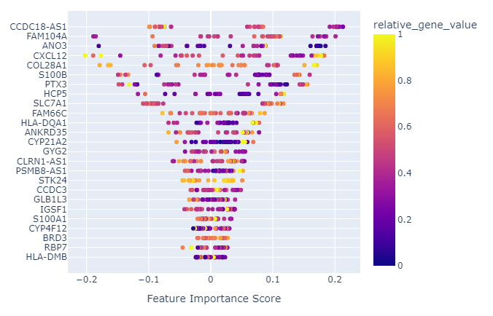
A2: Local Interpretable Model-Agnostic Explanations (LIME) on MRMR & XGBoost

Slide 22
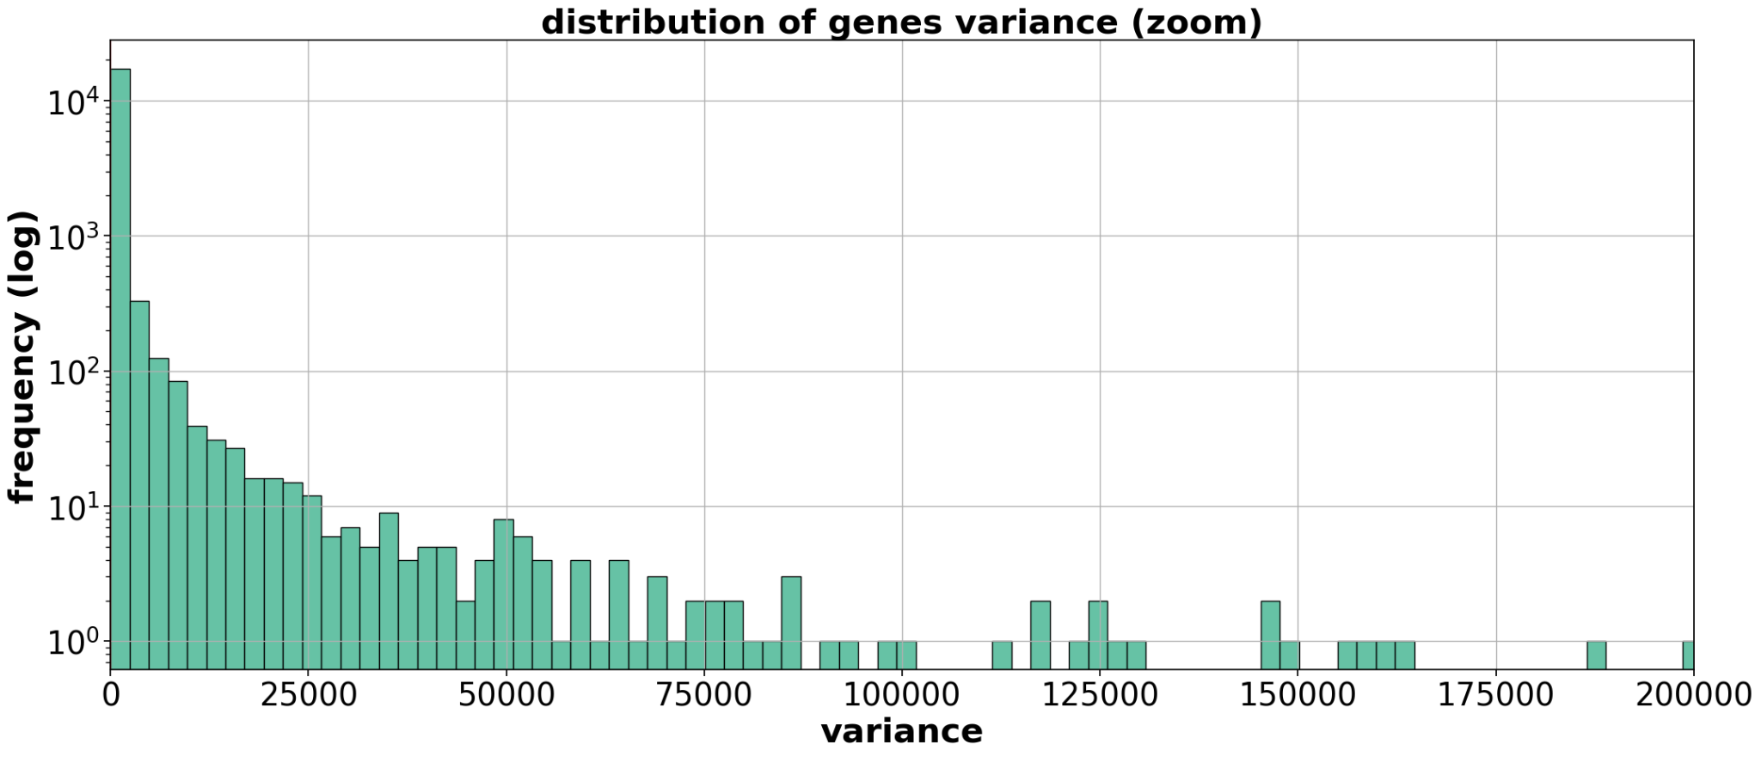
A3: Filtering through variance
Threshold line = 0.5
Removed ~10% of genes

Slide 23
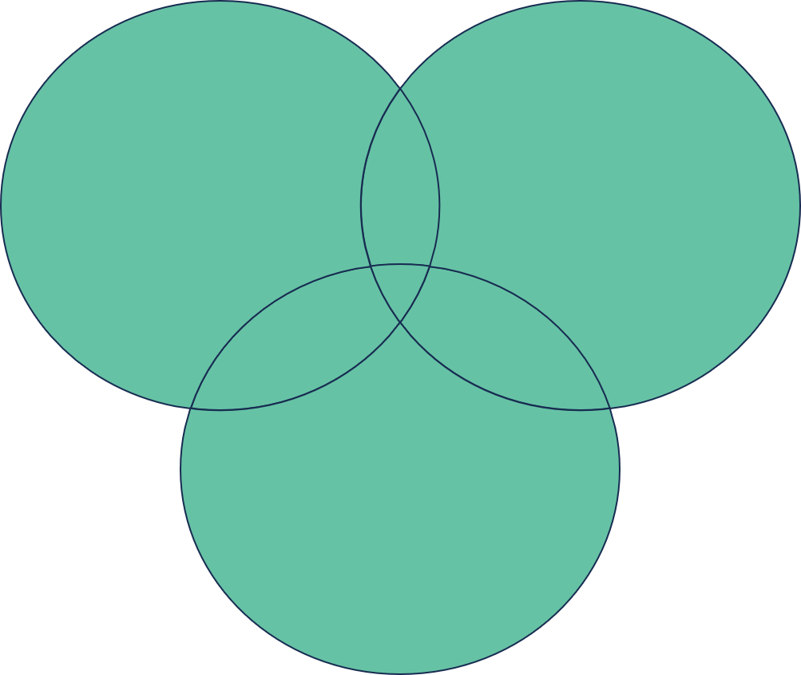
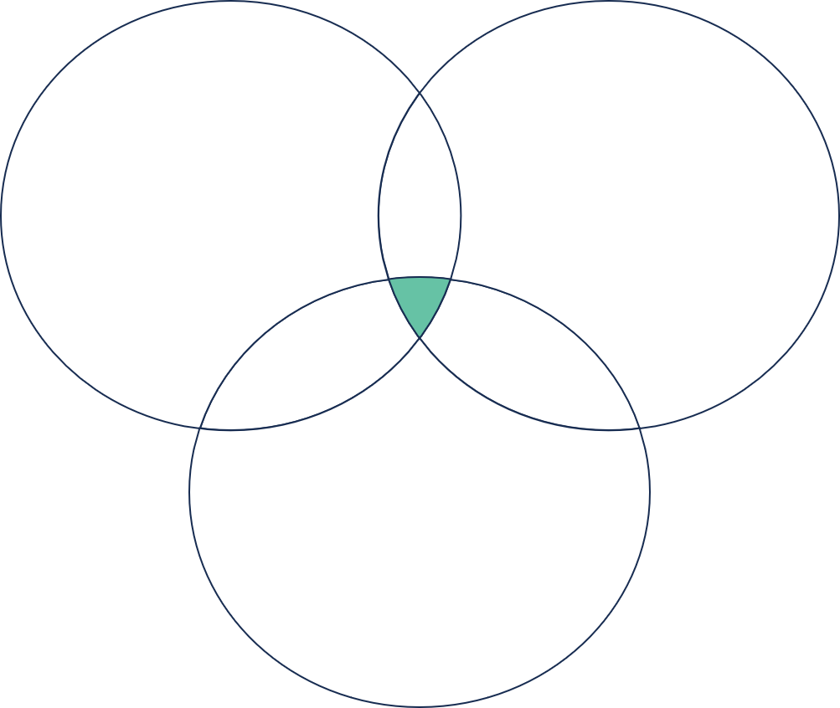
A4: Filtering Through Methods
Differential Expression Analysis
Wilcoxon Rank-Sum Test
Differential Expression Analysis
Wilcoxon Rank-Sum Test
Kolmogorov-Smirnov Test
Kolmogorov-Smirnov Test
2486 Genes
652 Genes

Slide 24


Slide 25







Our Pipeline
Use supervised methods to rank genes based on predictive ability
1. Get rid of low-variance genes
2. Statistical filters:
- DEA, rank-sum, KS
Data
Filter
Feature importance
Data with selected features
Interpretation
Modeling
Choose top k
SHAP, LIME
XGBoost,RF, Neural network
PCA, MRMR, Random Forest, Autoencoder

Slide 26
SHAP Interpretation on XGBoost with Random Forest
Gene expressions that leads to AMD (Top10):
Lower expressions leads to AMD (sort by importance):
Lower TRIM22
Higher expressions leads to AMD (sort by importance):
Higher MOXD1
Higher PTX3
Higher GAB3
Higher CPY21A2
Higher C2
Higher LTF
Higher NNMT
Higher C1S

Slide 27
Testing The Goodness of Features in AMD Prediction Using XGBoost
For each method, we select top 25 significant genes and train the XGBoost model with 100 bootstraps. Here are the averaged metrics of several hyperparameters sets. Therefore, we can compare these feature sets selected by these 6 methods.
 | PCA | MRMR | GLM | DEA | WRS | KS
Precision | 61% | 83% | 81% | 79% | 82% | 80%
Sensitivity | 82% | 89% | 88% | 88% | 88% | 88%
Specificity | 58% | 72% | 69% | 70% | 74% | 71%
F1 Score | 70% | 86% | 85% | 83% | 85% | 84%
 | PCA | MRMR | GLM | DEA | WIL | KS | RF
Precision | 61% | 83% | 81% | 79% | 82% | 80% | 84%
Sensitivity | 82% | 89% | 89% | 88% | 88% | 88% | 90%
Specificity | 58% | 72% | 69% | 70% | 74% | 71% | 73%
F1 Score | 70% | 86% | 85% | 83% | 85% | 84% | 87%
MRMR, WRS > GLM, DEA, KS >>> PCA
PCA=Principal Component Analysis, MRMR=Max Relevance Min Redundancy, GLM=Generalized Linear Model, DEA=Differential Gene Analysis by wald test, WRS=Wilcoxon Rank-Sum , KS=Kolmogorov–Smirnov test, RF=Random Forest

Slide 28
Testing The Goodness of Features in AMD Prediction Using Logistic Regression
For each method, we select top 25 significant genes and train the Logistic Regression model with 100 bootstraps. Here are the averaged metrics of several hyperparameters sets. Therefore, we can compare these feature sets selected by these 6 methods.
 | PCA | MRMR | GLM | DEA | WRS | KS | RF
Precision | 79% | 82% | 80% | 73% | 85% | 84% | 84%
Sensitivity | 81% | 87% | 84% | 85% | 86% | 85% | 83%
Specificity | 60% | 70% | 65% | 69% | 73% | 69% | 73%
F1 Score | 79% | 84% | 82% | 84% | 85% | 84% | 83%
 | PCA | MRMR | GLM | DEA | WRS | KS
Precision | 79% | 82% | 80% | 73% | 85% | 84%
Sensitivity | 81% | 87% | 84% | 85% | 86% | 85%
Specificity | 60% | 70% | 65% | 69% | 73% | 69%
F1 Score | 79% | 84% | 82% | 84% | 85% | 84%
MRMR, WRS, KS > GLM > PCA , DEA
PCA=Principal Component Analysis, MRMR=Max Relevance Min Redundancy, GLM=Generalized Linear Model, DEA=Differential Gene Analysis by wald test, WRS=Wilcoxon Rank-Sum , KS=Kolmogorov–Smirnov test, RF=Random Forest

Slide 29
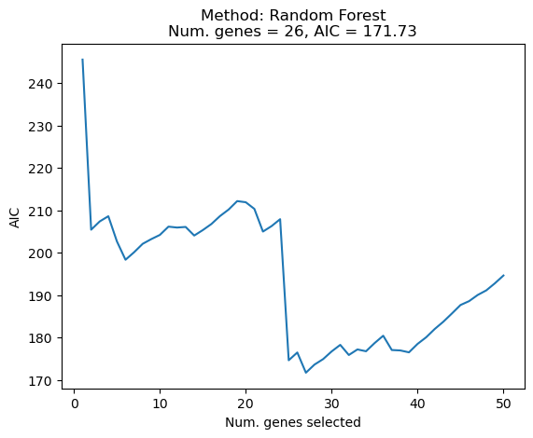
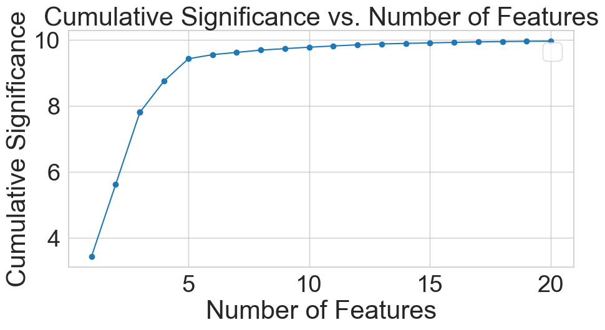
Next Steps: How many Genes?
Elbow plot
AIC/BIC
Notes:
Patrick

Slide 30
Comparison Between Feature Selection Methods
XGBoost:
MRMR, WRS > GLM, DEA, KS >>> PCA
Logistic Regression:
MRMR, WRS, KS > GLM > PCA , DEA
Conclusion:
Best Performance:
Max Relevance Min Redundancy,
Wilcoxon Rank-Sum
Other Methods:
Generalized Linear Model,
Kolmogorov–Smirnov test
Differential Gene Analysis
Principal Component Analysis

Slide 31
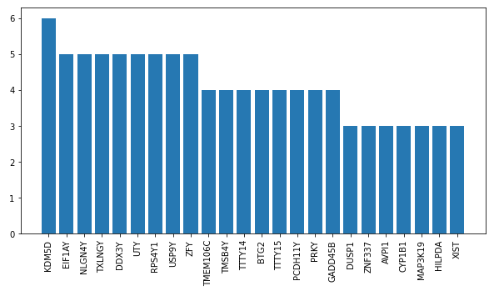
PCA feature selection
Counts
I select top 100 genes with the highest absolute coefficient for the top 20 PCs, which account for ~75% variance, and plot the genes that appear multiple times in 20 PCs.
Genes

Slide 32
Comparing Results
Selected 4 times:
C3, SYNC, HCP5, C1S
Selected 3 times:
BTN3A3, C2, PSMB8-AS1, PTGS1, NNMT, CFB, TNFRSF11B, HLA-DMB, S100B
Selected 2 times:
CXCL12, CYP4F12, HLA-DQA1, SERPING1, PLEKHS1, RARRES3, CCDC3, HLA-DMA, MOXD1
Based on top 25 genes from: MRMR, KS test, Random Forest, Optimal Transport, Differential Gene Analysis, and Rank-Sum.
Notes:
Patrick

Slide 33
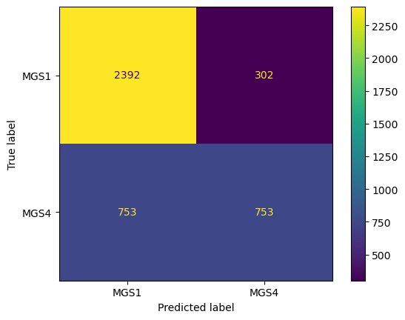
Model Performance
Random Forest with 100 bootstraps:
Precision is 76%
Sensitivity is 89%
Specificity is 50%
AUC is 70%

Slide 34
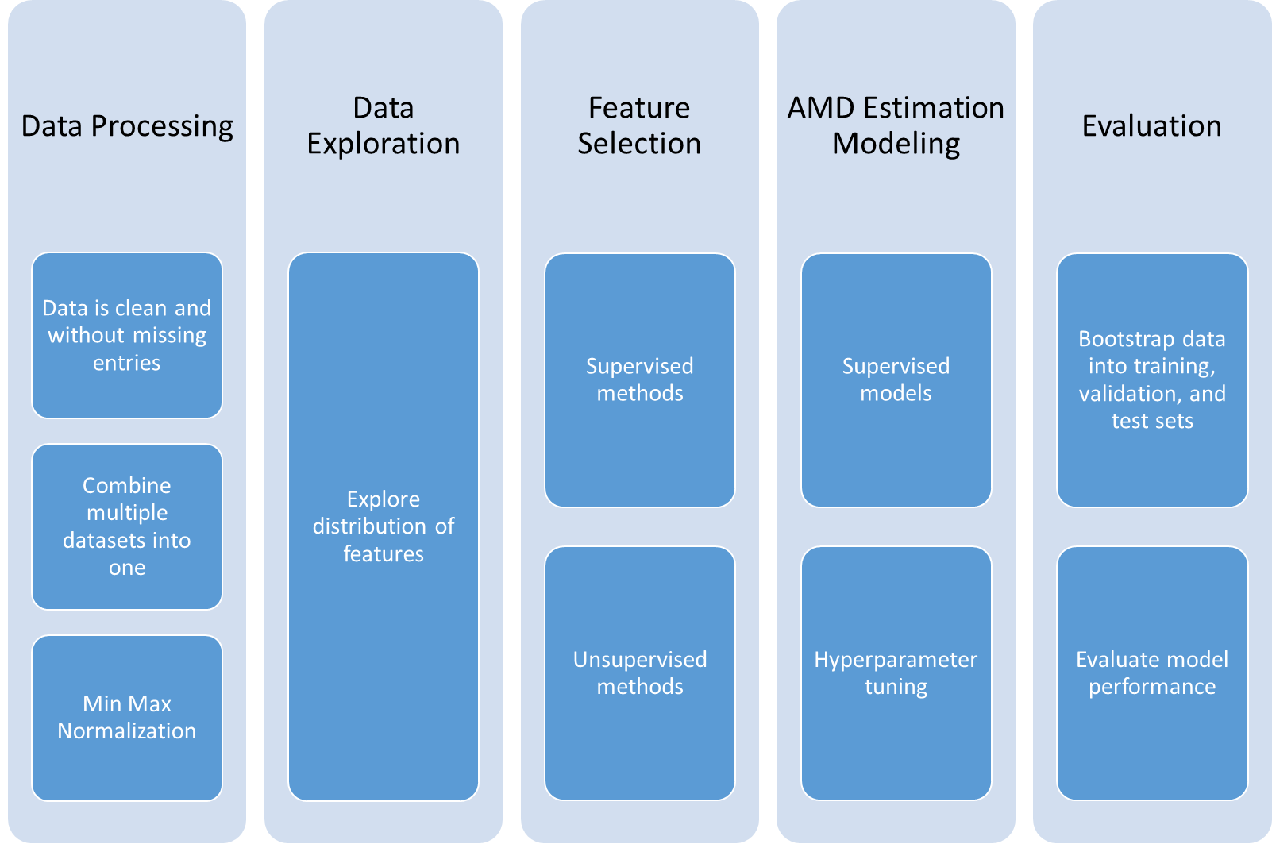
03
Data Science Pipeline
Notes:
Data Processing (clean, normalization)
Data Exploration (Tian), label distribution, etc.
Feature Selection : Supervised and unsupervised methods,
AMD estimation modeling: Supervised, training the model, hyperpar tuning etc.
Evaluation: Bootstrap the data into train, validation and test set and evaluate the performance using metrics like accuracy, confusion matrices and ROC, Feature selection we look at the relative importance scores

Slide 35
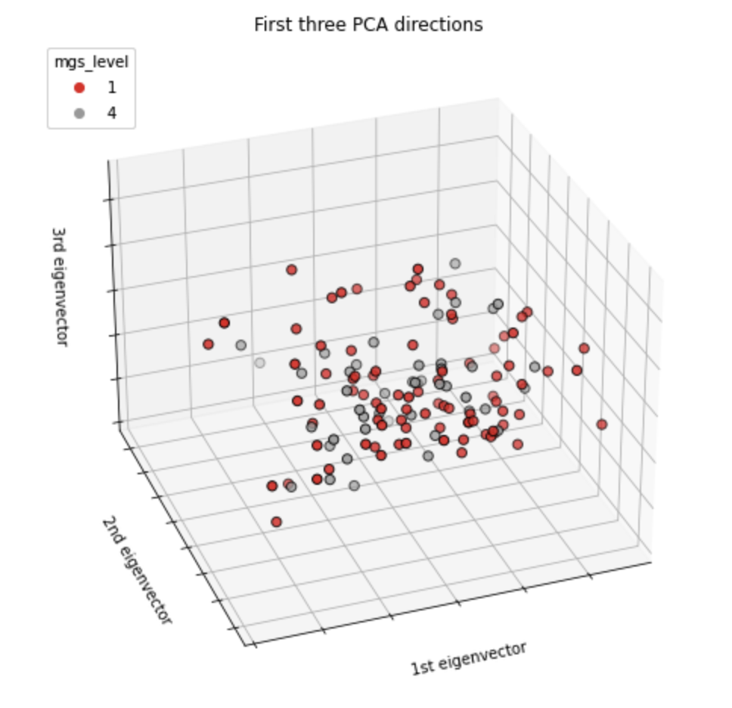
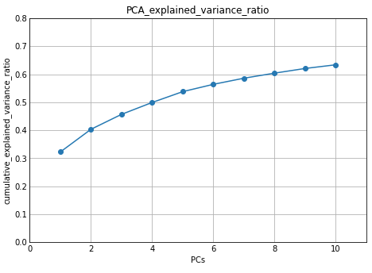
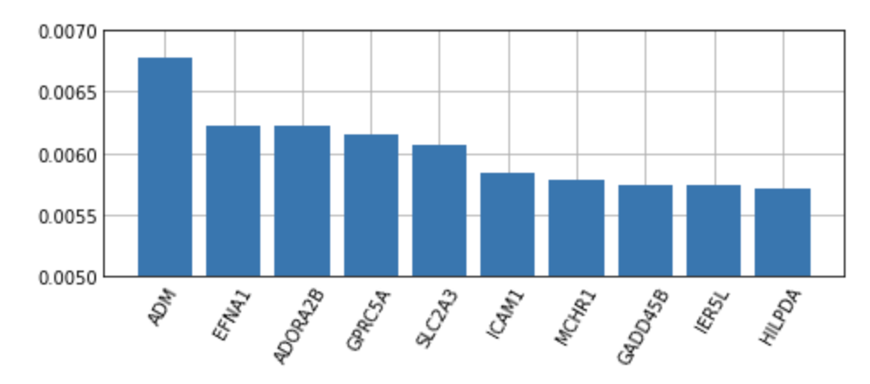
Unsupervised: PCA
PCA fitting, transforming, view the training dataset in first 3PC
Find the top 10 features of largest coefficient for PC1

Slide 36
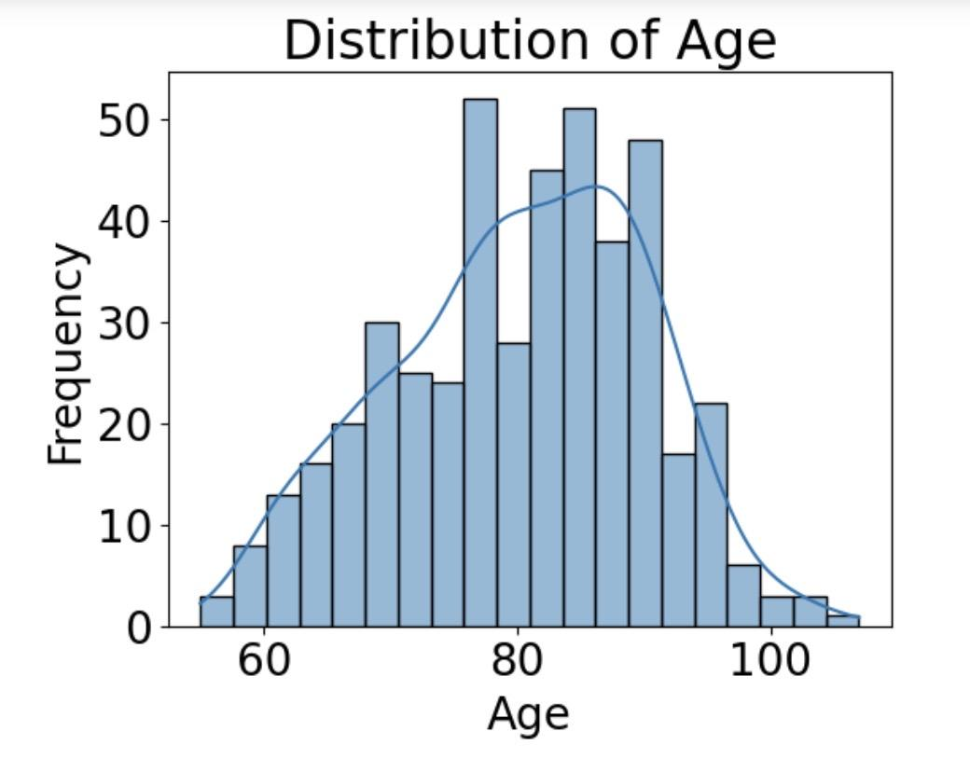
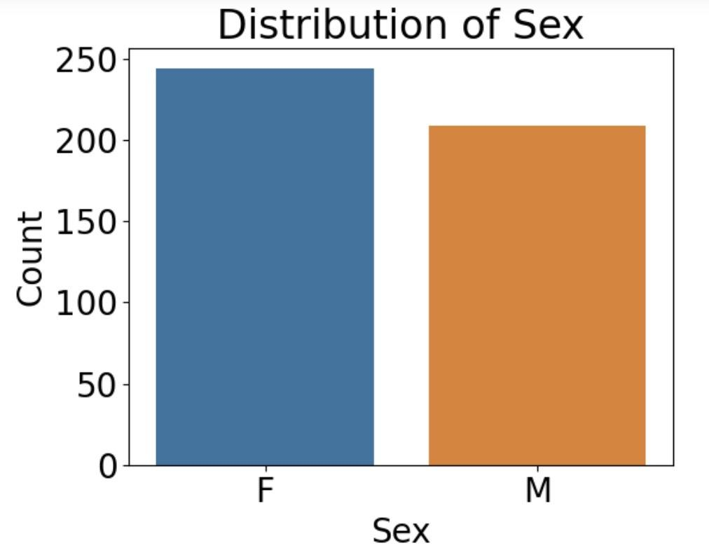
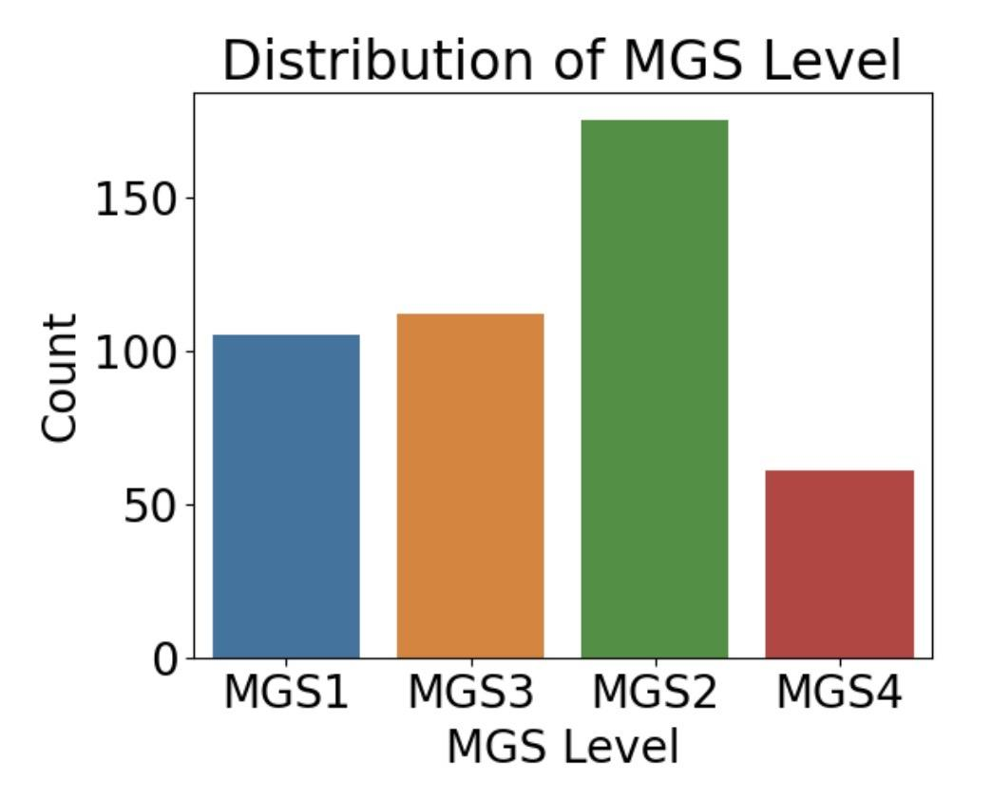
Data
Gene data:
453 patients by 18056 genes, normalized counts by patient.
-No missing data but some zeros
Metadata:
-453 patients by 2o columns,
Including information of id, mgs_level (label), age, sex, race, left or right eye,, medical history, ocular history, death time and etc.
-No missing data in age and sex,
-Some missing data and typo in other category

Slide 37
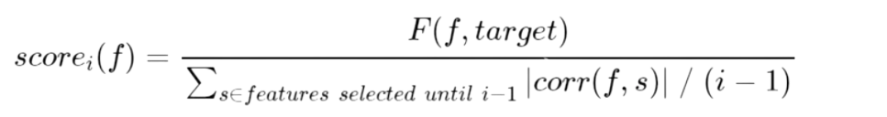
Max Relevance - Min Redundancy (mRMR)
Feature Selection
What
Why
How
mRMR ranks features based on an importance score
Importance calculated from
Relevance - the feature correlation to target
Redundancy - the feature correlation to other features in previous iterations
Want to get top k features with
High relevance to target variable
Small redundancy
Many methods to compute mRMR
Research has shown FCQ method to be high-performing and efficient
F-statistic relevance
Correlation (Pearson) redundancy
Pearson correlation between the current feature and previous features
Quotient computation scheme

Slide 38
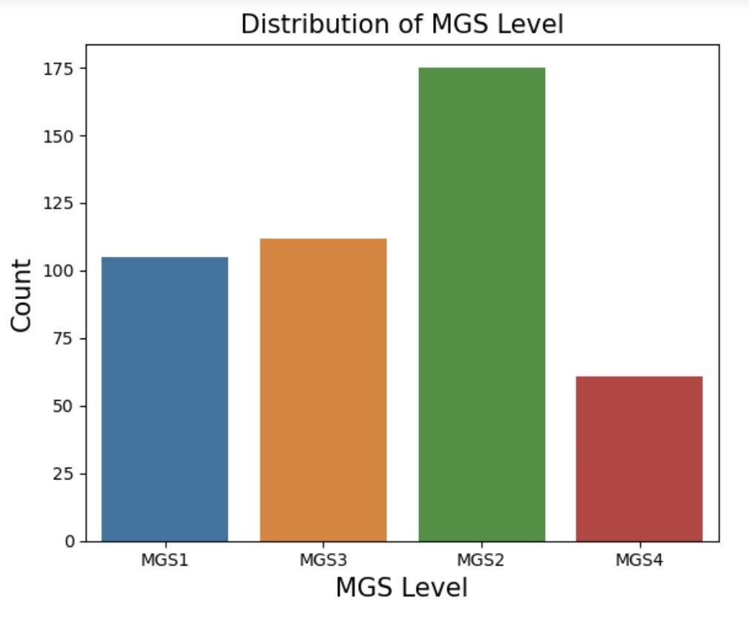
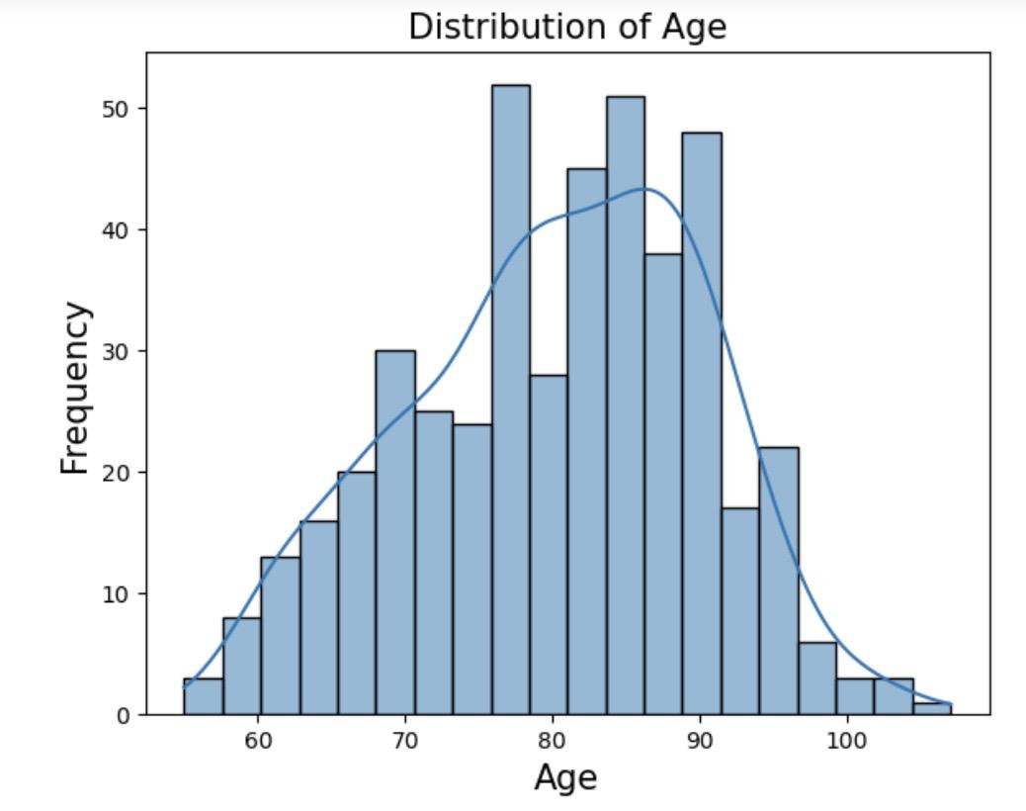
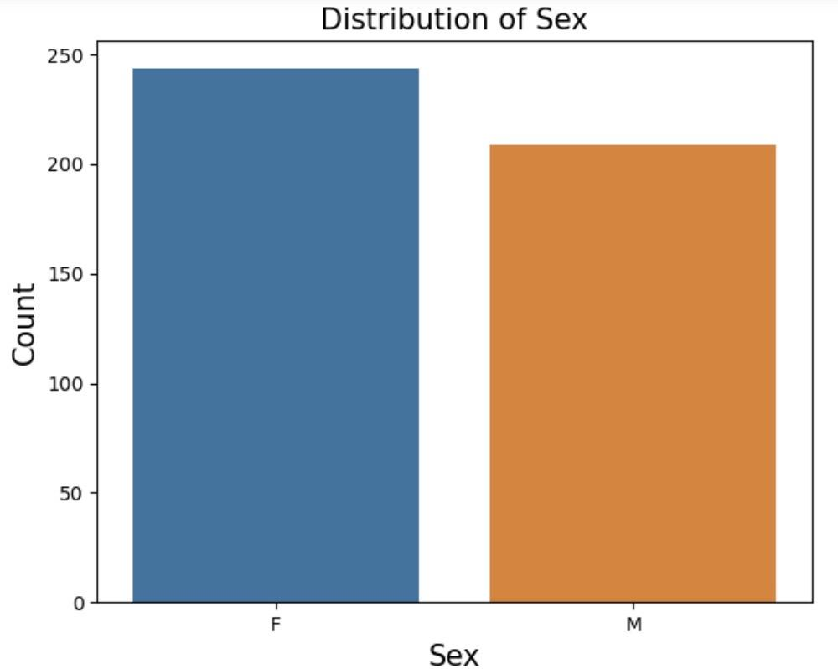
Quick Look at the Data

Slide 39


Summary of Feature Selection Methods
Metrics | GLM | KS Test | Logistic Regression (ElasticNet) | GSEA | PCA | Random Forest | MRMR | t-SNE
Interpretability | High | Medium | High |  | High | Medium | High | Low
Category | Statistical | Statistical | Supervised |  | Unsupervised | Supervised | Supervised | Unsupervised
Pros | Easy to interpret Handle different target distributions | Agrees with Random Forest. Finds many genes known to be related to AMD. | Identified features with high correlation to the target |  | Easy to interpret | Agrees with KS. Finds many genes known to be related to AMD. | Finds many genes known to be related to AMD. | Can visualize the data in low dimension
Cons | Large number of trial and error runs | Low specificity (Risk of type I error). | Could not identify all features with biological significance |  | 1.Only linear, 2. univariate analysis not considering gene interaction 3. Only variance. | Gene selection subject to stochasticity. | Greedy nature, so may not find optimal sets | Sensitive to parameter choice, Non-linear, Not for feature selection

Slide 40
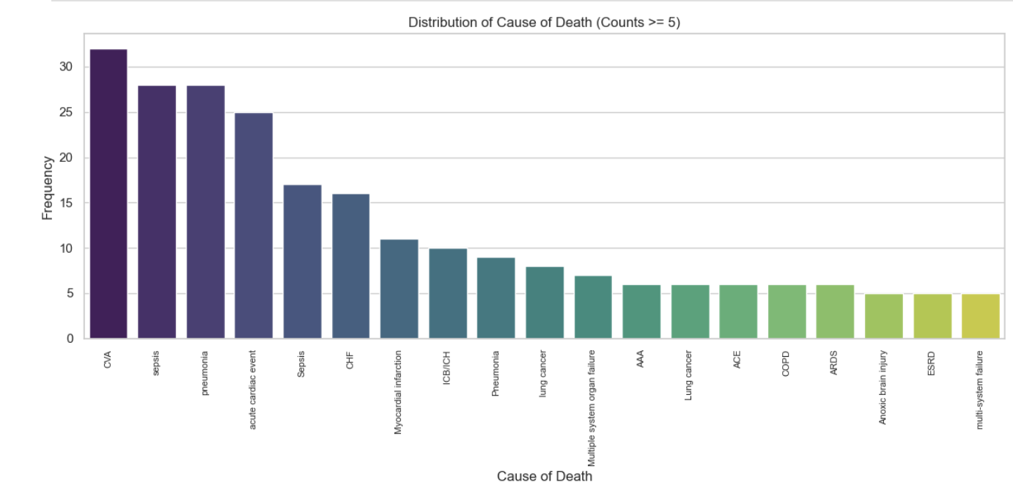
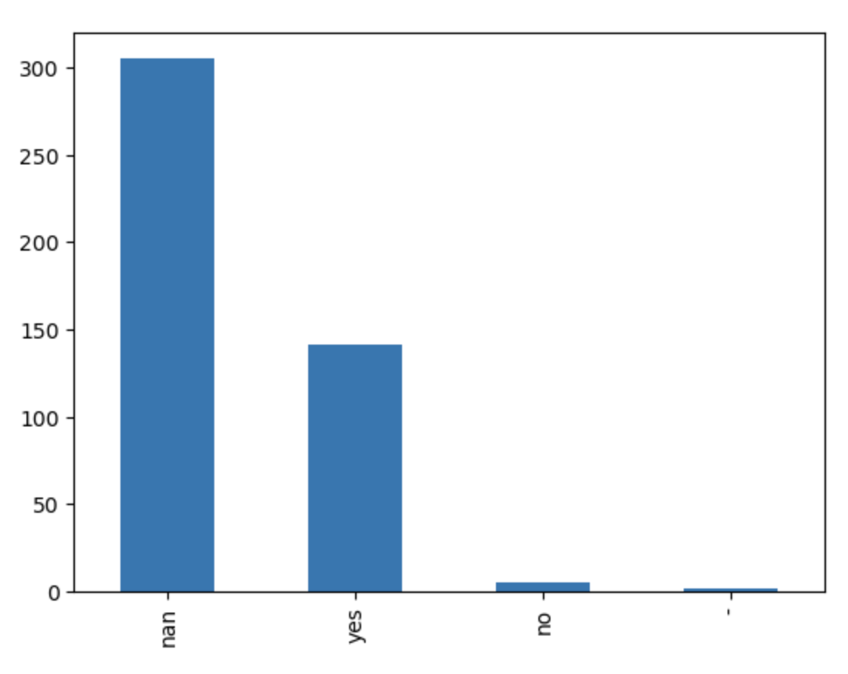
Data
Cataract
(Stroke)
Medical history and other factors are highly likely to affect the gene expression
Notes:
Or should we compensate for that?

Slide 41
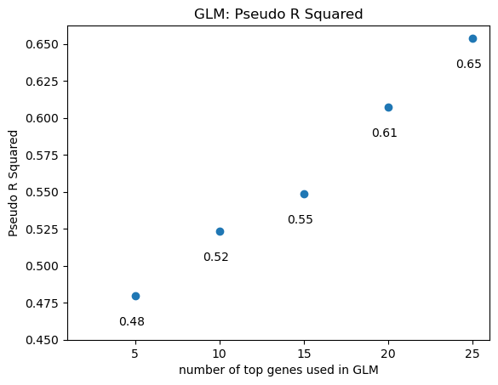
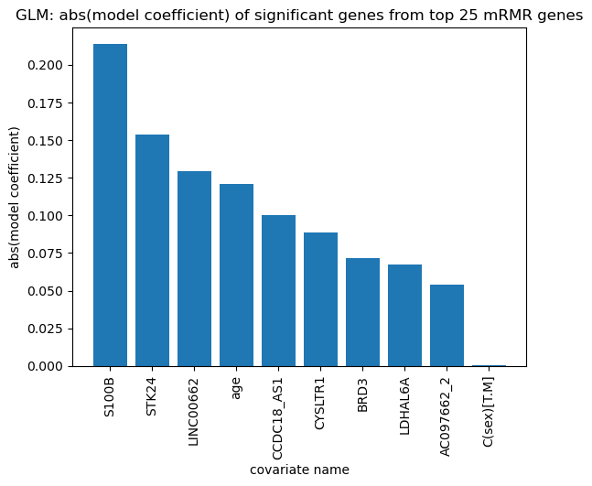
Generalized Linear Model (GLM)

Slide 42
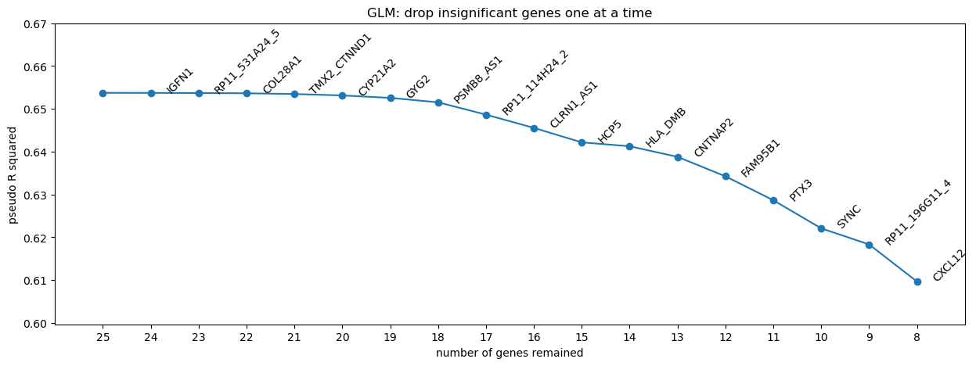
Generalized Linear Model (GLM)

Slide 43
Elastic Net Regularization for feature selection in Logistic Regression
How
What
Why
Hybrid regularization technique in Logistic Regression.
Combines L1 (Lasso) and L2 (Ridge) penalties.
Used for feature selection and model regularization.
Feature Selection: To automatically identify the most relevant gene expression features for the task.
Overcoming Overfitting: To mitigate overfitting and improve model generalization on gene expression data.
Enhancing Predictive Accuracy: By selecting relevant features, it aims to boost the predictive accuracy of the model.
Hyperparameter Tuning: We used cross-validation to find the best settings (alpha and l1_ratio) for Elastic Net Logistic Regression.
Feature Filtering: We try 20 different threshold values to decide which gene expression features are important based on their strength.
Accuracy Evaluation: We check how accurate our model is for each threshold value.
Selecting the Best Threshold: We pick the threshold value that gives us the highest accuracy, helping us choose the most useful gene expression features.

Slide 44
DEA Analysis for Feature Selection
Differential Expression Analysis (DEA) means taking the normalised read count data and performing statistical analysis to discover quantitative changes in expression levels between experimental groups. (which is “mgs_level” in our project).
Comparing the expression levels of genes across different groups
Identifying those genes that are expressed at significantly higher or lower levels in one group compared to another.
The result of a DEA includes a list of significant genes ranked by their p-values, which represent the probability that the observed difference in expression levels occurred by chance. Adjusted p-values are also computed to control the false discovery rate, allowing researchers to discern the genes most likely to be genuinely differentially expressed.

Slide 45
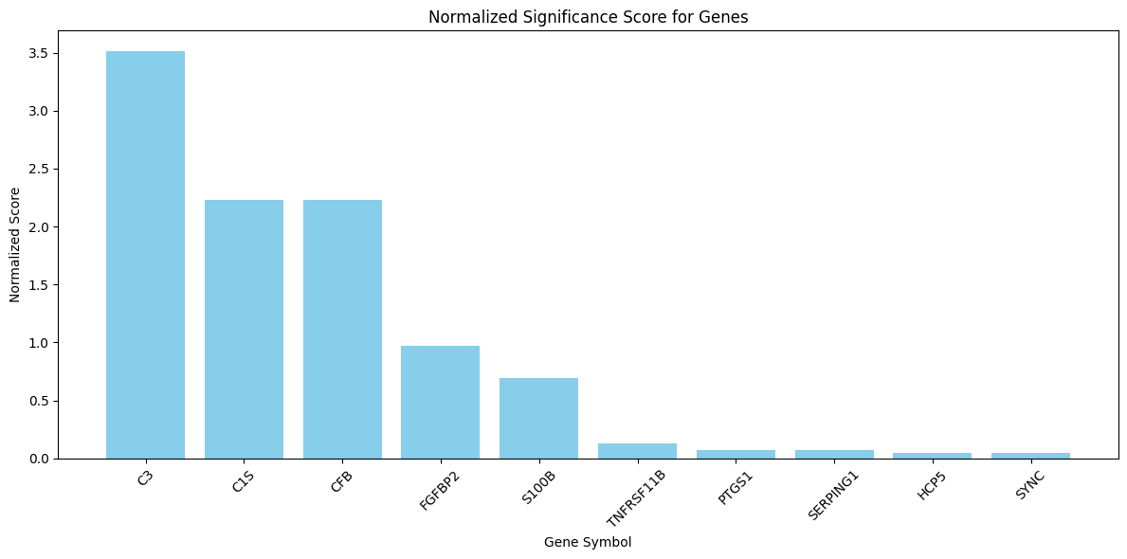
DEA Analysis: Significance Score & Ranking

Slide 46
Presentation structure
Note: fix everything according to the feedback for last presentation
Background/junk from last time + data (45 seconds) Suji
Updated Pipeline (1:30 Minutes?) (EDA -> filter variance -> filter stats -> comparison -> topk -> modeling) Duy + Qingxin
Briefly list methods that have been used (45 seconds?) Tian
Comparison: Green thing, final list of genes that were selected by lots of things ( 45 seconds) Patrick
Modeling: Initial results + next steps (45 Seconds) <- Precision, sensitivity/specificity, AUC… Wanying
-Presentation done by Sunday night. Meet 3:30 to run through 2x
-Report: Fix citations, modeling

Slide 47
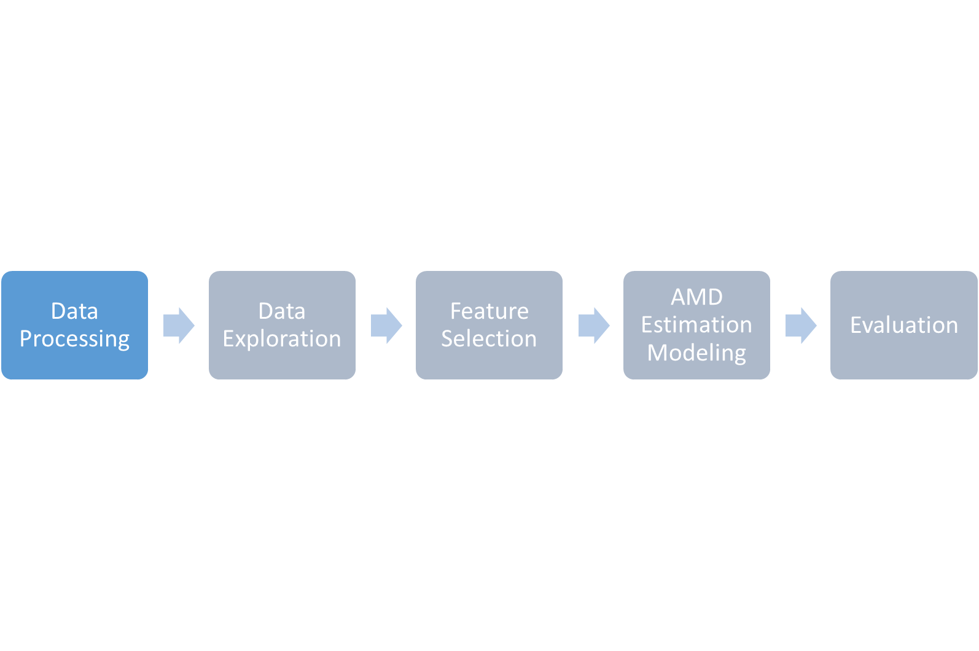





Clean data
No invalid/outlier entries
No missing entries
Combining data from multiple sources
Patient demographic metasheet
Patient genomic dataset
Normalization needed
Min-max normalization
Notes:
Since our data is clean and there are no missing values for key features, the data processing phase largely involves combine datasets of genes and metadata, and normalization

Slide 48
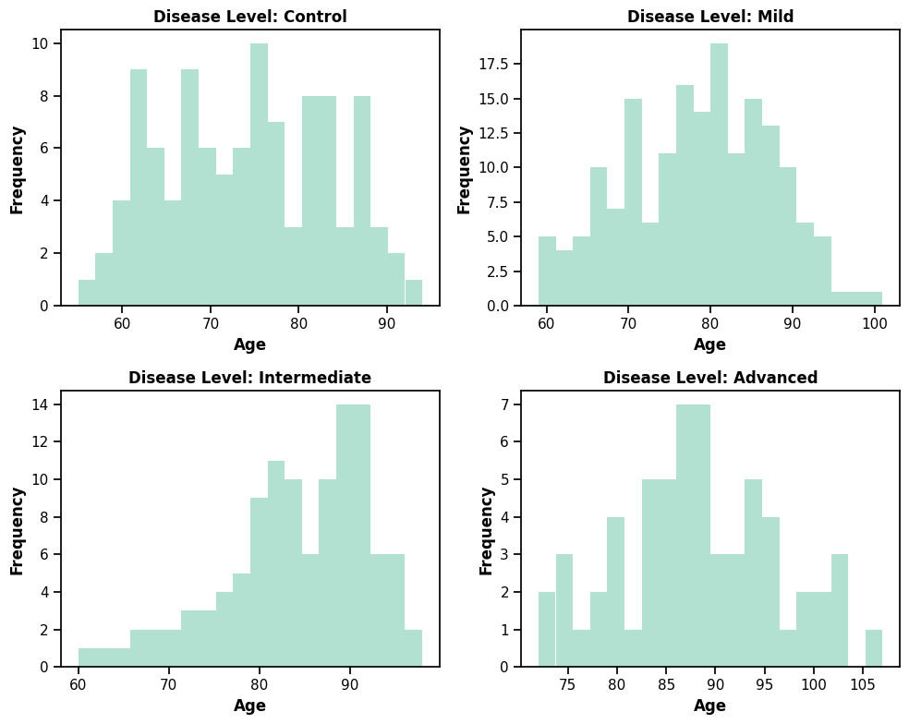
Quick Look at the Data: Age

Slide 49
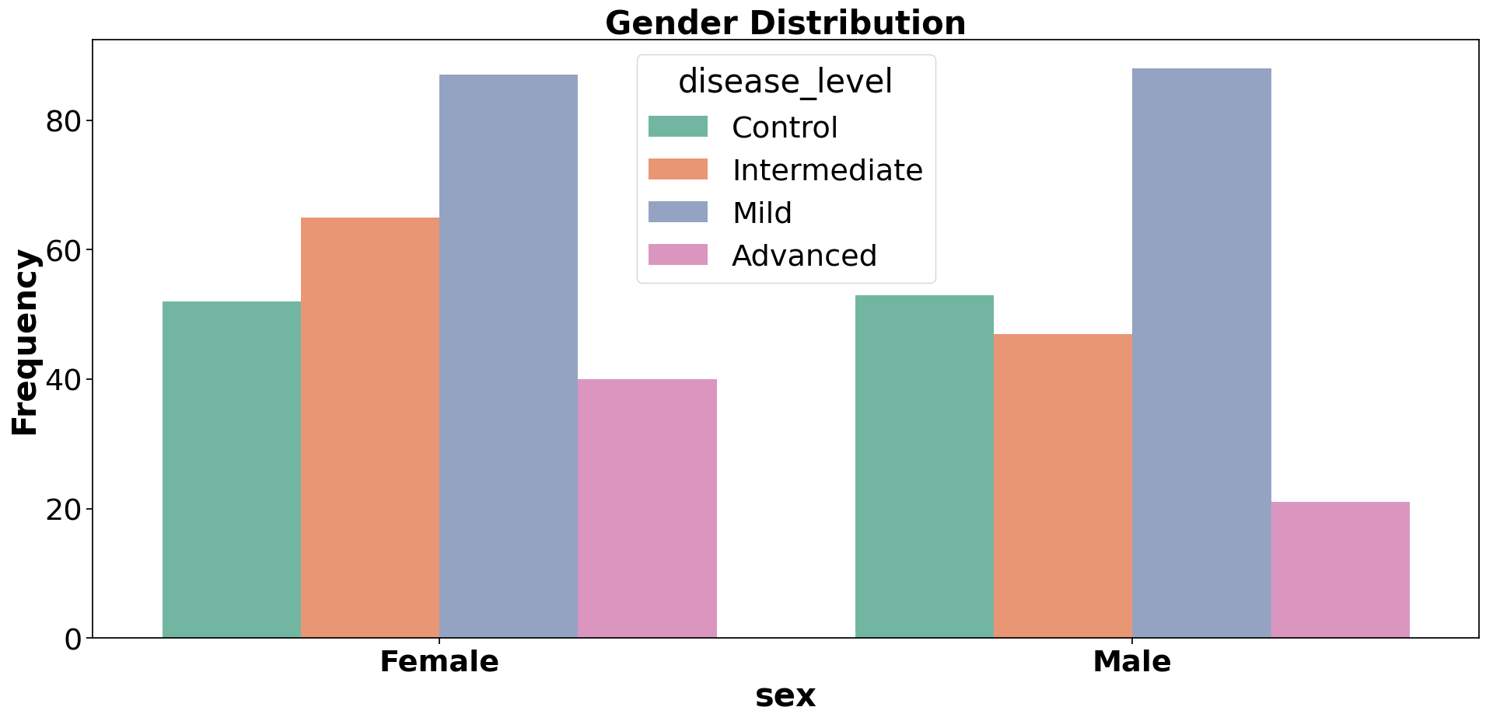
Quick Look at the Data: Gender
Notes:
Females overall are higher

Slide 50
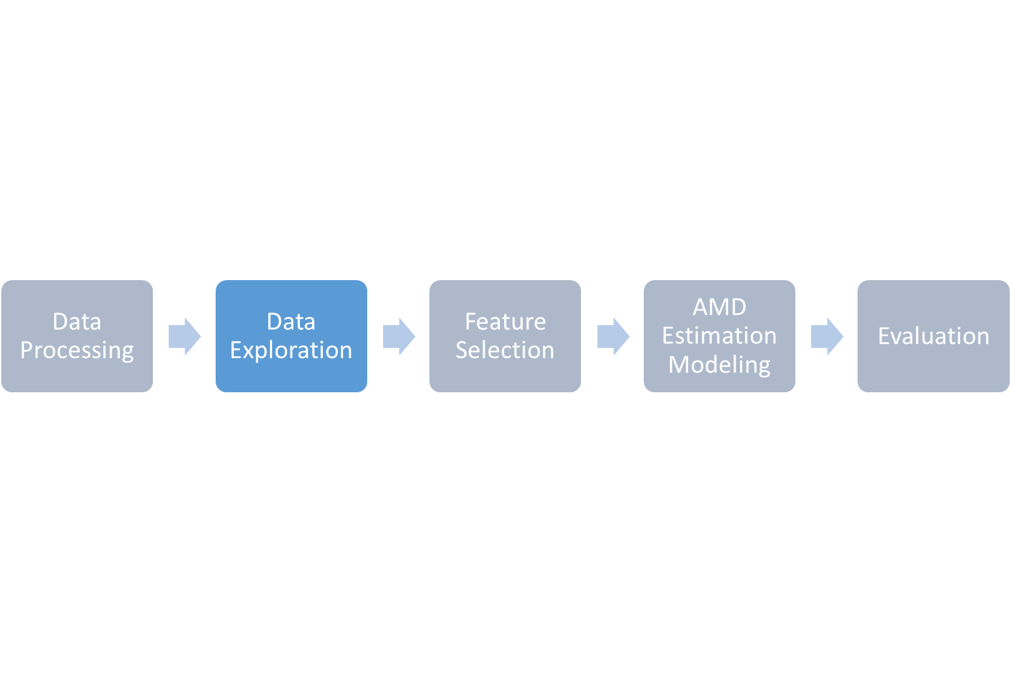
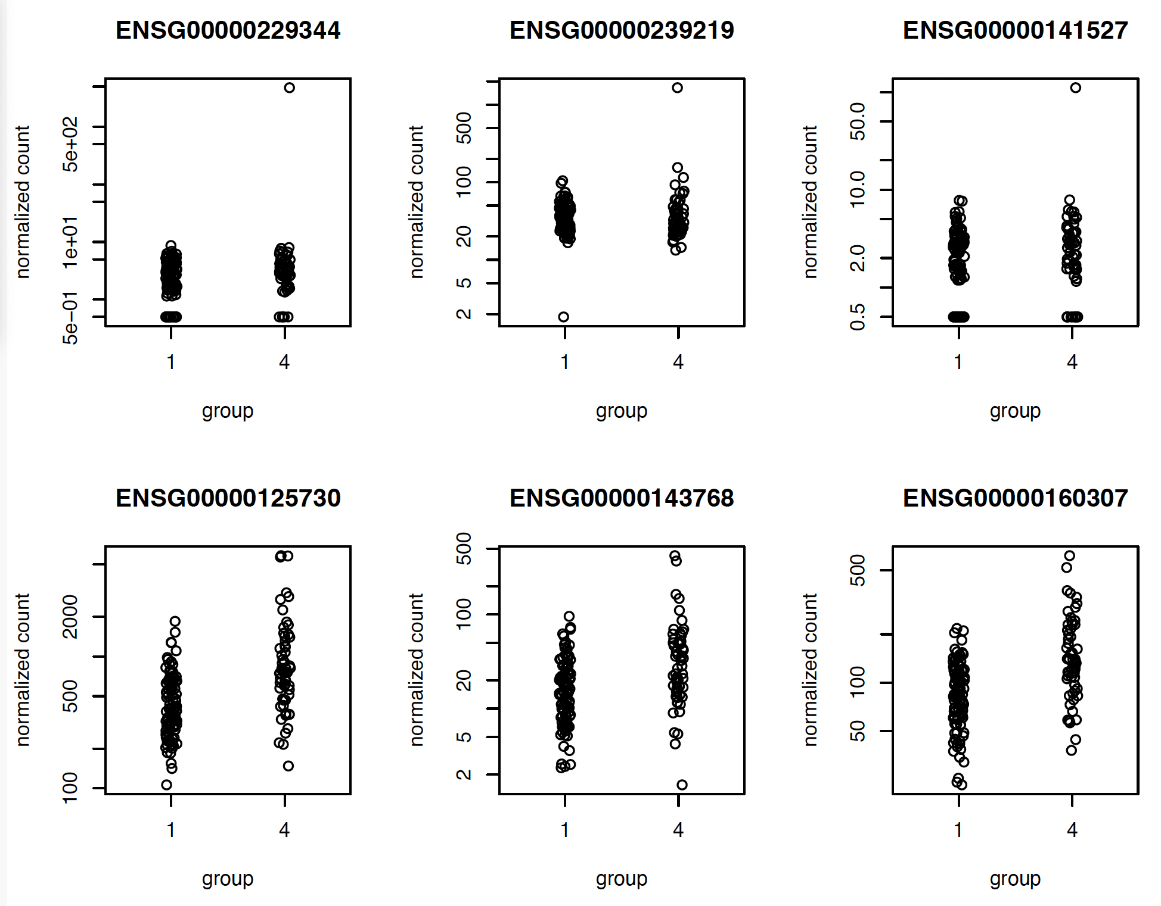
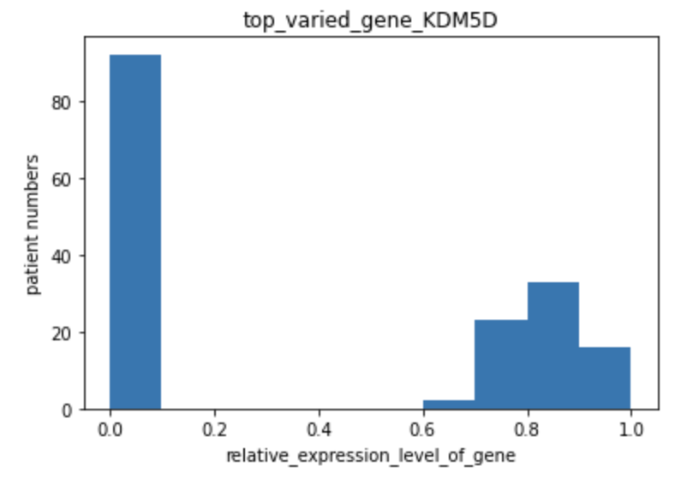
Top varied gene after normalization
Notes:
During the data exploration phase, we familiarize ourselves with the dataset we get, and create plots to visualize the distributions of genes and metadata
The two histogram showing on the slide are distributions of top varied genes, they further prove that we need to normalize data for each gene

Slide 51
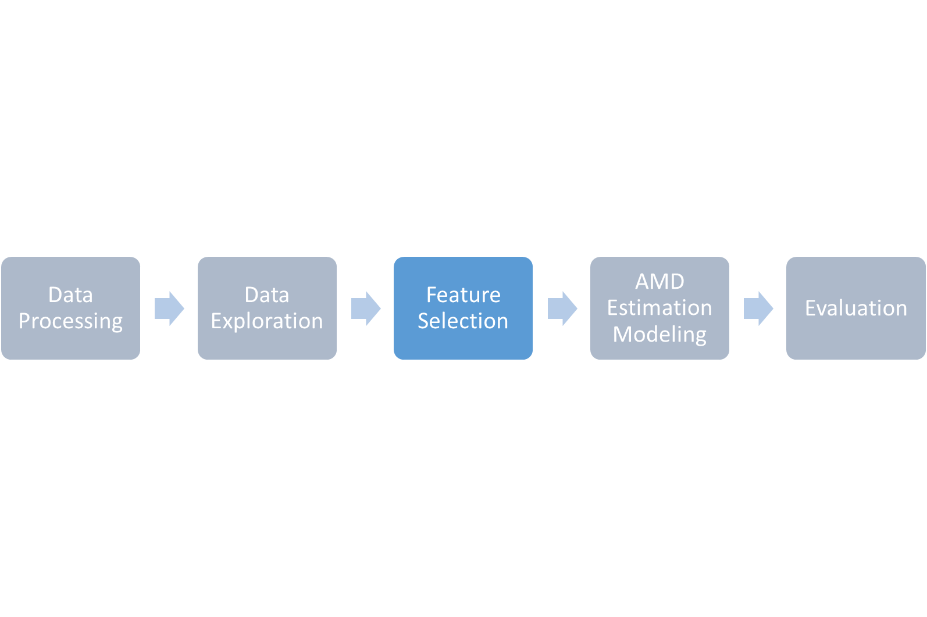
Unsupervised Methods for dimensionality reduction & visualization e.g.
Principal Component Analysis (PCA)
t-distributed Stochastic Neighbor Embedding (t-SNE)
Supervised Methods for feature importance e.g.
Max Relevance; Min Redundancy (MRMR)
Random Forest
Notes:
Our feature selection phase will involve two categories of methods. The first are unsupervised methods such as PCA and tSNE for the purpose of dimensionality reduction and visualization. Our actual feature selection will come from the much more interpretable supervised methods such as MRMR and Random Forest.

Slide 52
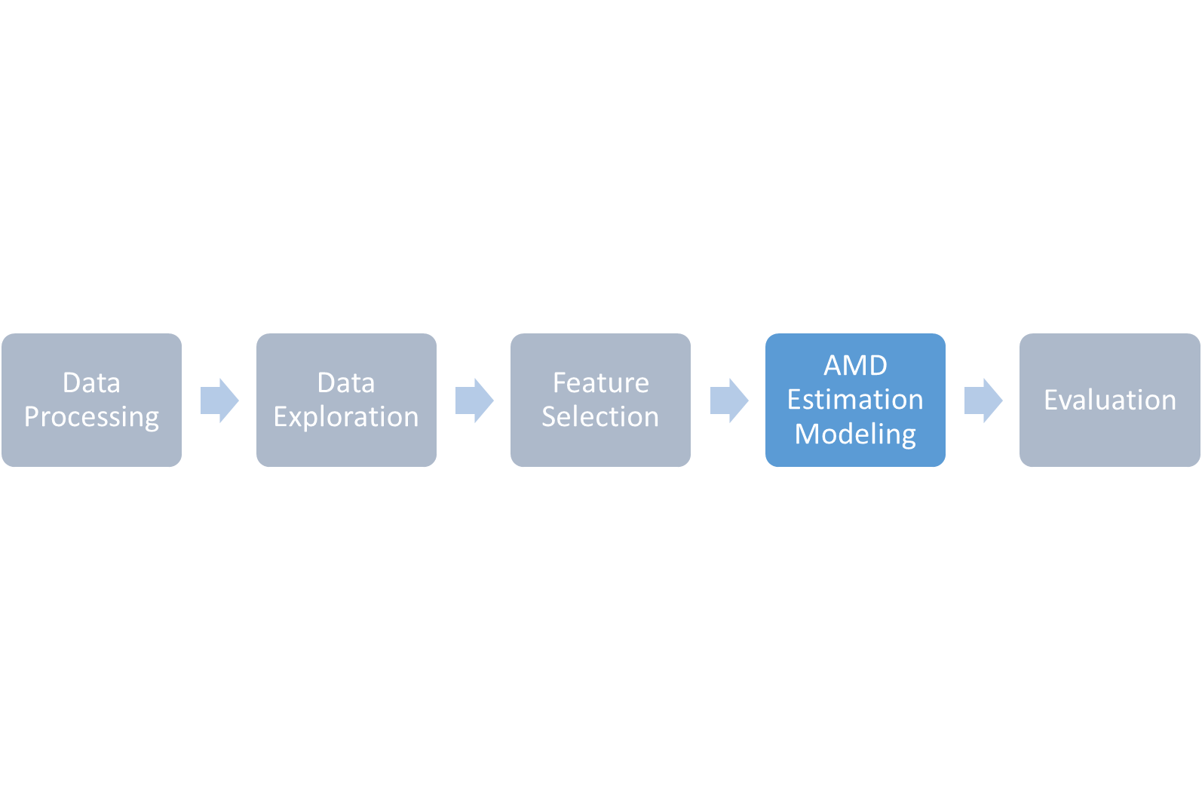
Supervised Methods, e.g.
Random Forest
Support Vector Machines
Neural Networks
Hyperparameter Tuning, e.g.
Grid Search
Random Sampling
Notes:
Given that our data comes with labels for AMD severity, we aim to build our estimation model using supervised methods such as random forest, support vector machines, and neural networks. We then want to perform hyperparameter tuning (wherever applicable) using techniques such as grid search or random sampling.

Slide 53
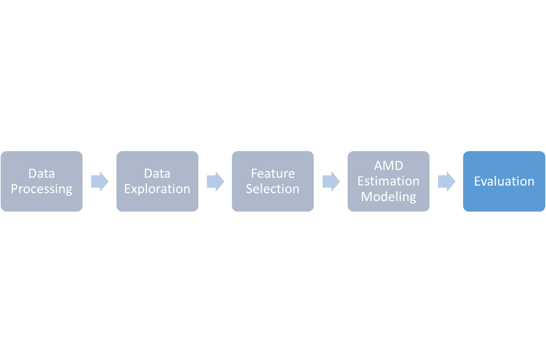
Bootstrapping for Generalization
Sample into separate sets: training, validation, and test
Repeating it multiple times
Performance Metrics
Accuracy
Confusion matrix
Receiver Operating Characteristic (ROC) curve
Notes:
To see how well our model performs, we will bootstrap our data into separate sets, repeating that many times due to our limited samples. And from the bootstrapping, we will consider several performance metrics such as raw accuracy, confusion matrices for false positives and false negatives, and the Receiver Operating Characteristic curve with its respective AUC score

Slide 54
Quick Look at the Data
Label Distribution

Slide 55
Module 2 - Data Exploration: normalization
Top varied gene after normalization

Slide 56
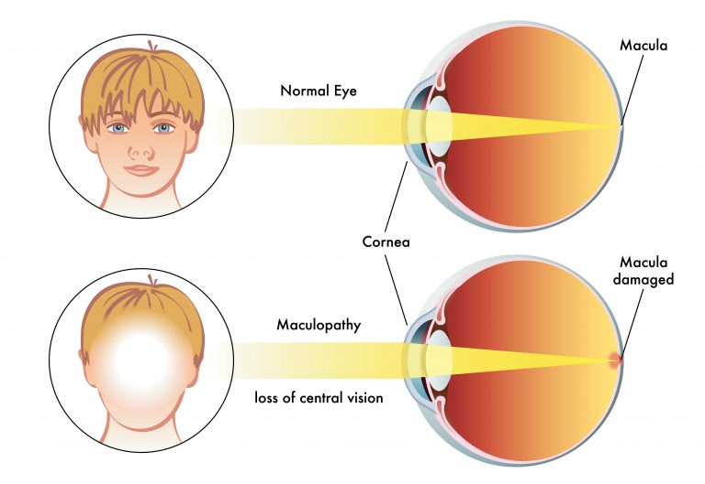
Age-related Macular Degeneration: Motivation
Project Objectives
Identify information related to AMD
Apply interpretable ML models
Potential to be useful for early diagnosis and therapy
Notes:
Project Objectives
Identify and extract relevant information related to AMD from high-dimensional, scarce genes data
Apply interpretable ML models to classify patients into AMD severity levels.
Would be useful for: Early diagnosis, preventative/remedial drugs, etc.

Slide 57
Module 2 - Data Exploration: Outliers
Notes:
During the data exploration phase, we dive deeper into the genes data.
Here we are visualizing 6 genes in particular and compare control group with advanced disease level group to detect outliers

